Slide 1



Sales Dashboard
View in Power BI
Last data refresh:
2/20/2022 4:31:17 PM UTC
Downloaded at:
2/20/2022 4:44:40 PM UTC

Slide 2
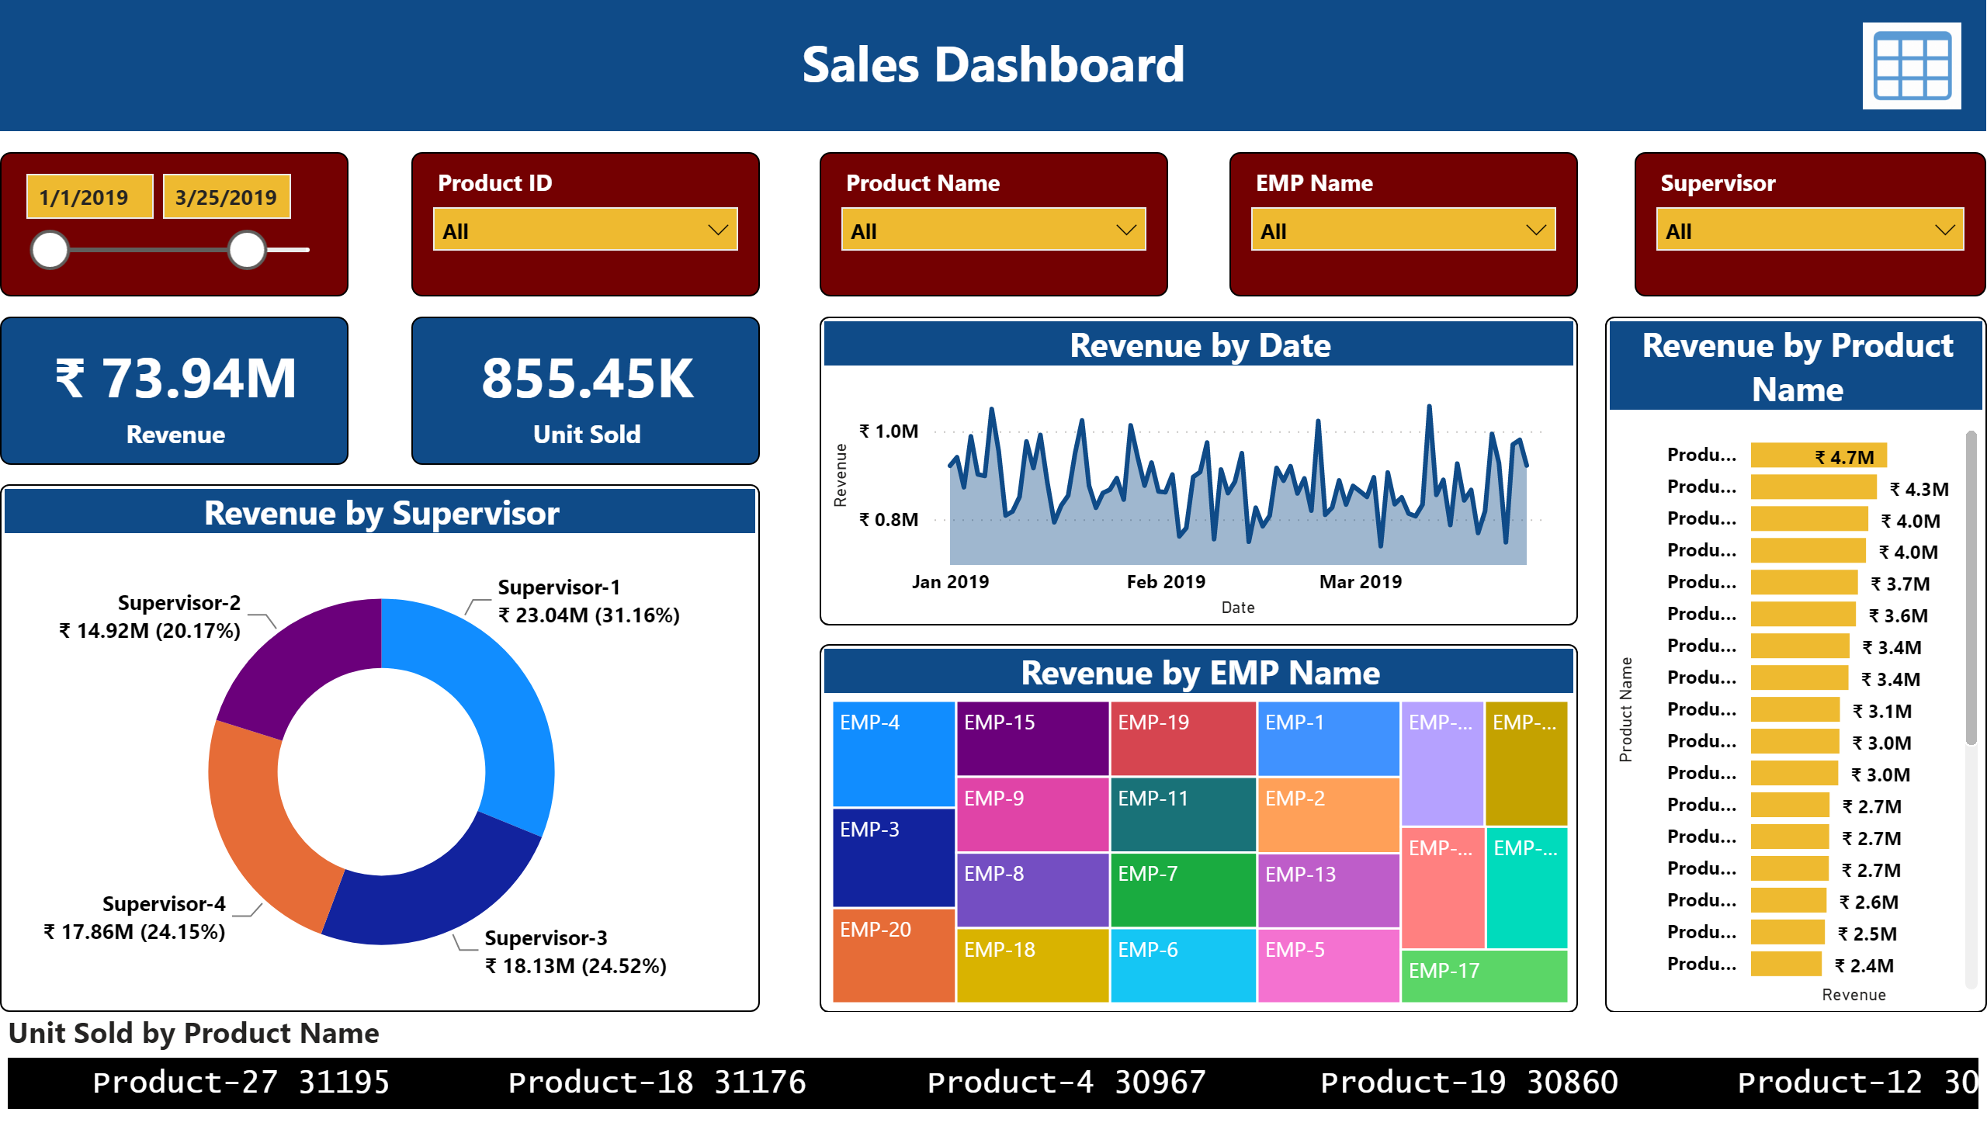
Dashboard
Notes:
shape
No alt text provided
textbox
No alt text provided
slicer
No alt text provided
slicer
No alt text provided
slicer
No alt text provided
slicer
No alt text provided
slicer
No alt text provided
card
No alt text provided
card
No alt text provided
donutChart
No alt text provided
areaChart
No alt text provided
treemap
No alt text provided
clusteredBarChart
No alt text provided
ScrollingTextVisual1448795304508
No alt text provided
image
No alt text provided

Slide 3
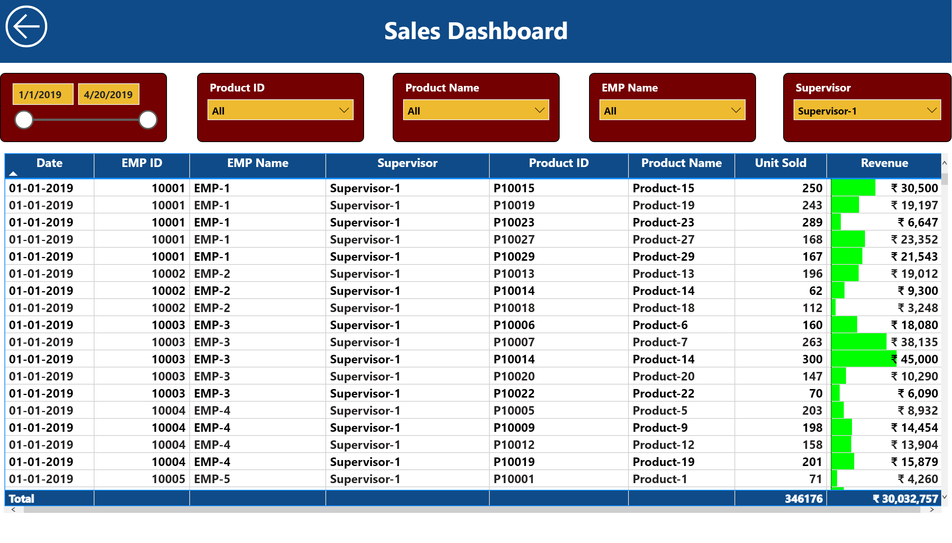
Table View
Notes:
shape
No alt text provided
textbox
No alt text provided
slicer
No alt text provided
slicer
No alt text provided
slicer
No alt text provided
slicer
No alt text provided
slicer
No alt text provided
actionButton
No alt text provided
tableEx
No alt text provided

